Slide 1

Bangladesh Army University of Engineering & Technology
Department of Computer Science and Engineering
EEE 2261: Electrical Drives and Instrumentation
Winter 2025 Semester
Lecture-07
Course Teacher
S. M. Ashik Al Mashrafi
Lecturer, EEE, BAUET
Total Credit: 3.0 Credit Taking: 3.0

Slide 2
Course Content
Chapter | Topics
Introduction | Three phase circuits, alternators and transformers, principles & operation of DC Machines, synchronous, induction, universal and stepper motors, thyristor and microprocessor-based speed control of motors
Instrumentation Amplifiers | Differential, logarithmic, and chopper amplifiers, frequency and voltage measurements using digital techniques, recorders and display devices, spectrum analyzers and logic analyzers, data acquisition and interfacing to microprocessor-based systems;
Transducers | Terminology, types of transducers, principles and applications of photovoltaic, piezoelectric, thermoelectric, variable resistance and opto-electronics transducers. Noise reduction in instrumentation

Slide 3
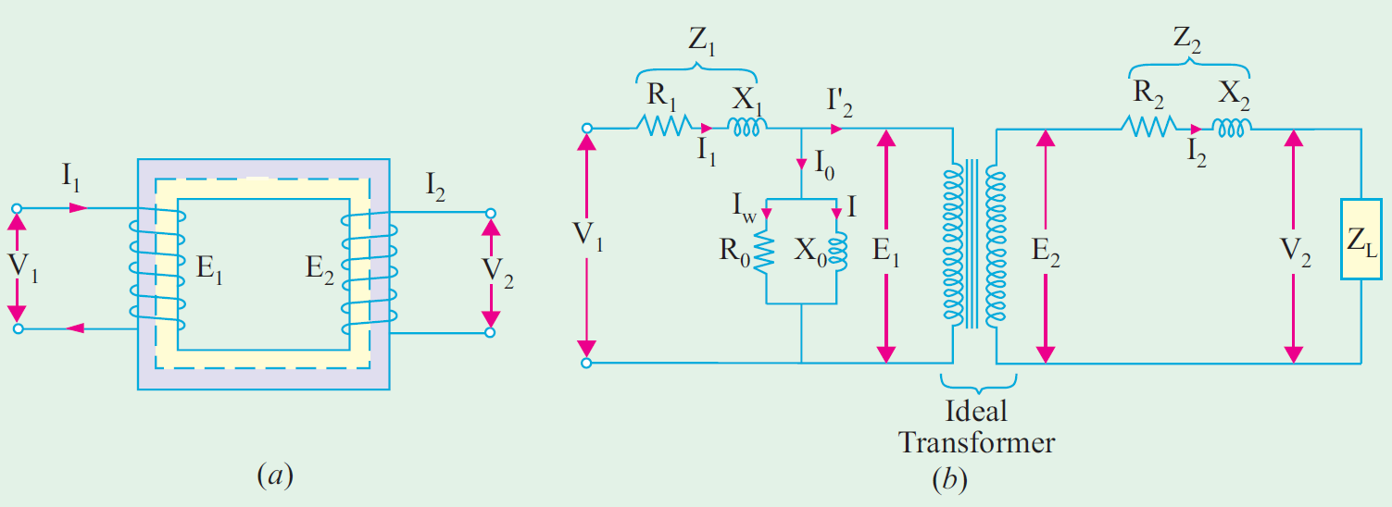
Equivalent Circuit of Transformer
Fig. 1: Equivalent circuit of transformer.

Slide 4
Equivalent Circuit of Transformer
R₁, R₂: Winding Resistance
X₁, X₂: Magnetic Leakage
R₀: No load working component
X₀: No load magnetizing component
Fig. 1: Equivalent circuit of transformer.

Slide 5
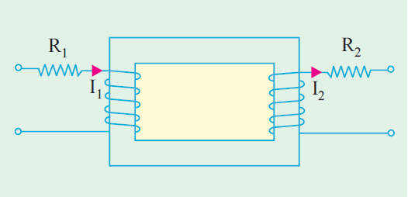
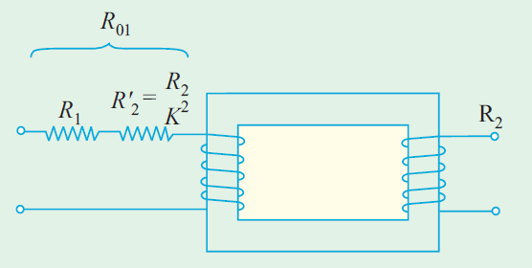
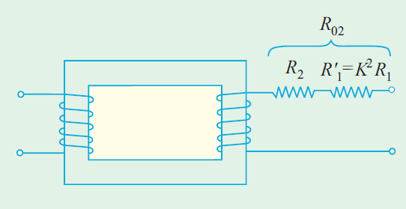
Equivalent Resistance
(a)
(b)
(c)
Fig. 2: (a) Transformer with primary and secondary winding resistance, (b) Equivalent secondary resistance as referred to primary., (c) Equivalent resistance as referred to secondary.

Slide 6
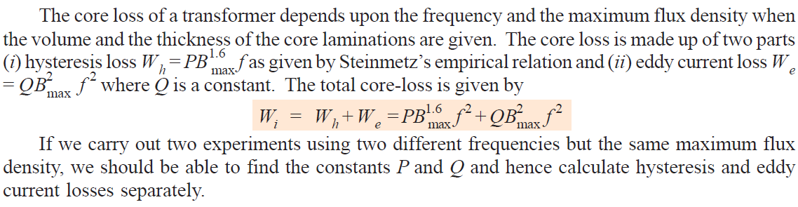
Separation of Core Losses

Slide 7
Why transformer rating is in KVA?

Slide 8
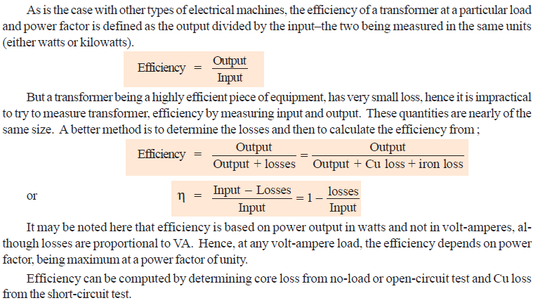
Efficiency of a Transformer

Slide 9
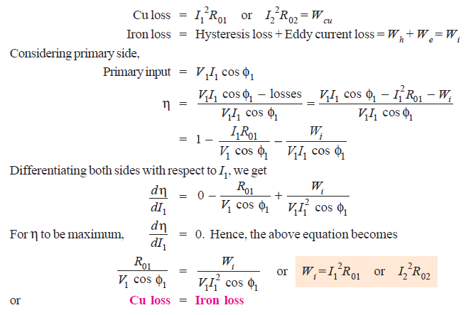
Condition for Maximum Efficiency

Slide 10
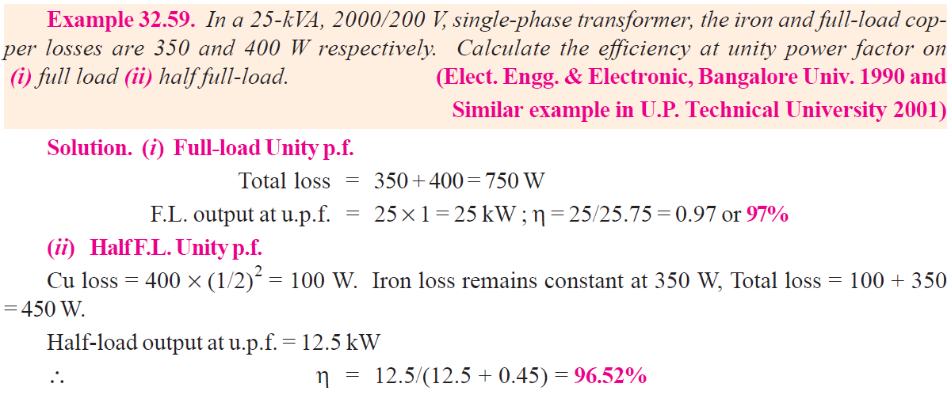
Mathematical Problem

Slide 11
Mathematical Problem (for practice)
SL No. | Name of the Book | Name of the Author (s) | Example
1 | A Text Book of Electrical technology | B.L Theraja | 32.61 32.64 32.76

Slide 12
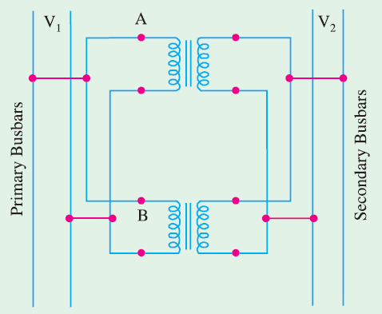
Parallel Operation of Single-phase Transformers
For supplying a load in excess of the rating of an existing transformer, a second transformer may be connected in parallel. It is seen that primary windings are connected to the supply bus bars and secondary windings are connected to the load bus-bars. In connecting two or more than two transformers in parallel, it is essential that their terminals of similar polarities are joined to the same bus-bars.
Fig. 3: Parallel operation of single-phase transformers.

Slide 13
Parallel Operation of Single-phase Transformers
Conditions for parallel operation:
1. Primary windings of the transformers should be suitable for the supply system voltage and frequency.
2. The transformers should be properly connected with regard to polarity.
3. The voltage ratings of both primaries and secondaries should be identical. In other words, the transformers should have the same turn ratio i.e. transformation ratio.
4. The percentage impedances should be equal in magnitude and have the same X/R ratio in order to avoid circulating currents and operation at different power factors.

Slide 14
Thank You
For Your Attention

